Slide 1



ICLD-projekt
Umeå – Cau Giay, Ha Noi
2019-2022
ESD – From knowledge to action

Slide 2
Motivation from ICLD,
International Center for Local Democracy
The ICLD considers the applications to be relevant, feasible and sustainable. The problem is identified as clear lack of capacity at the institutional level and is deemed important for the development of local democracy. The possibility for institutionalization of the results becomes evident in the project objectives. Furthermore, the theme of sustainable development is urgent and relevant and has a strong connection to local democracy and to the MPPs core areas especially equity/inclusion and citizen participation. The broad sustainability of the project is strengthened further through the partnership's second application, focusing on the school managers of Cau Giay.
You have been granted a total of SEK 3 900 000 for the period applied for.
Feedback: Thank you for two good and interesting project applications and a annexed steering group! Below is a short feedback that may help the partnership along the way. Although the ESD and Agenda 2030, as the application describes, are closely linked to the ICLD core areas, it is important not to lose focus on core areas. It is within one or more of these core areas that ICLD wants to see a development. There is a strength in having two parallel projects, one aimed at school leaders and one for teachers. Together, the projects are given the opportunity for a broad change directly. However, it may be wise to ensure that the projects are not dependent on each other but can contribute to democracy development individually. Good luck!

Slide 3
School leaders
Project period 1 - Investigate
- Get to know each other's cultures
- Knowledge in ESD
- Develop strategic plan
- Partner Schools
Year
2012-2015
Educators
Year
2015-2018
Project period 2 - Strategic management
- Implement strategic plan
- Spread knowledge
- Develop methods
- Educate "spreaders"
Steering, administrative management
Steering, administrative manangement
School leaders
Transform knowledge into action
- Apply past experiences to implement the Sustaianble Developoment Goals, SDG:s.
- Identify sucessful factors in order to create meaningfulness and action amongst students.
Year
2019-2022
Educators
Children/Students

Slide 4

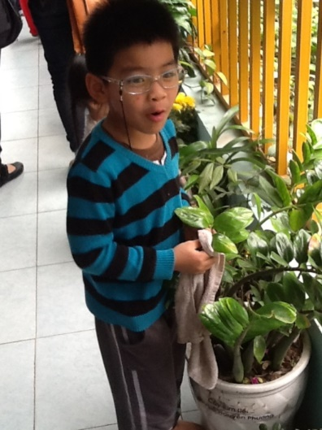
Knowledge + Values = Action

Slide 5
Third projectperiod???
Develop strategic and practical action for schools and pre-schools to include the goals of Agenda 2030 in teaching
In the business concerning preschools and schools
In all subjects in preschools and schools
Overall Subjects working with for example the area climate change using math, social science natural science, English and so on.
Starting from national and local goals
Government decisions – like the curriculum
School Administration's mission – the politicians idea around ESD
The municipality's strategic goals
Contact schools - all preschools in each school area
Develop teaching methods
Measure the effects of these in children and students
Comparative measurements with other schools / preschools
Exchanging experiences and learning methods with other preschools/schools in the area.
Finding examples how to transform knowledge to action.

Slide 6

The Global Goals 2015-2030

Slide 7
Intermediate objectives
Projekt 1: Managers
Projekt 2: Educators
1. Structure for Education and Learning, leaders. Timetable. Struktur för utbildning och lärande, ledare. Tidplan. | 1. Structure for Education and Learning, educators. Timetable. Struktur för utbildning och lärande, pedagoger. Tidplan.
2. Content education, focus on transformation, knowledge-based action. Commitment Agenda 2030. Innehåll utbildning, fokus på transformation, kunskap-handling. Meningsfullhet Agenda 2030. | 2. Content education, knowledge that leads to behavioral change. Commitment Agenda 2030. Innehåll utbildning, kunskap som leder till beteendeförändring. Meningsfullhet Agenda 2030.
3. Routines for follow-up and assessment. Rutiner för uppföljning och bedömning. | 3. How can we connect the goals in Agenda 2030 to the curriculum goals? All subjects. Hur kan vi koppla målen i Agenda 2030 till läroplansmålen? Alla ämnen.
4. Spread to leaders (within the school area) Spridning till ledare (inom skolområdet) | 4. Teaching and evaluation Undervisning och utvärdering

Slide 8
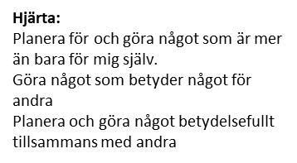


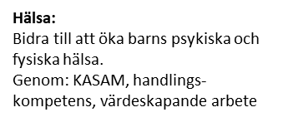

Heart: Plan for and do something more than just for myself. Do something that matters to others. Plan and do something meaningful with others.
Brain: Knowledge, Analysis, Creativity
Health: Help to increase children's mental and physical health through feeling of context, action skills and value-creating work.
Act: Writing, discussing, influencing, changing habits, making demands, contributing

