Slide 1
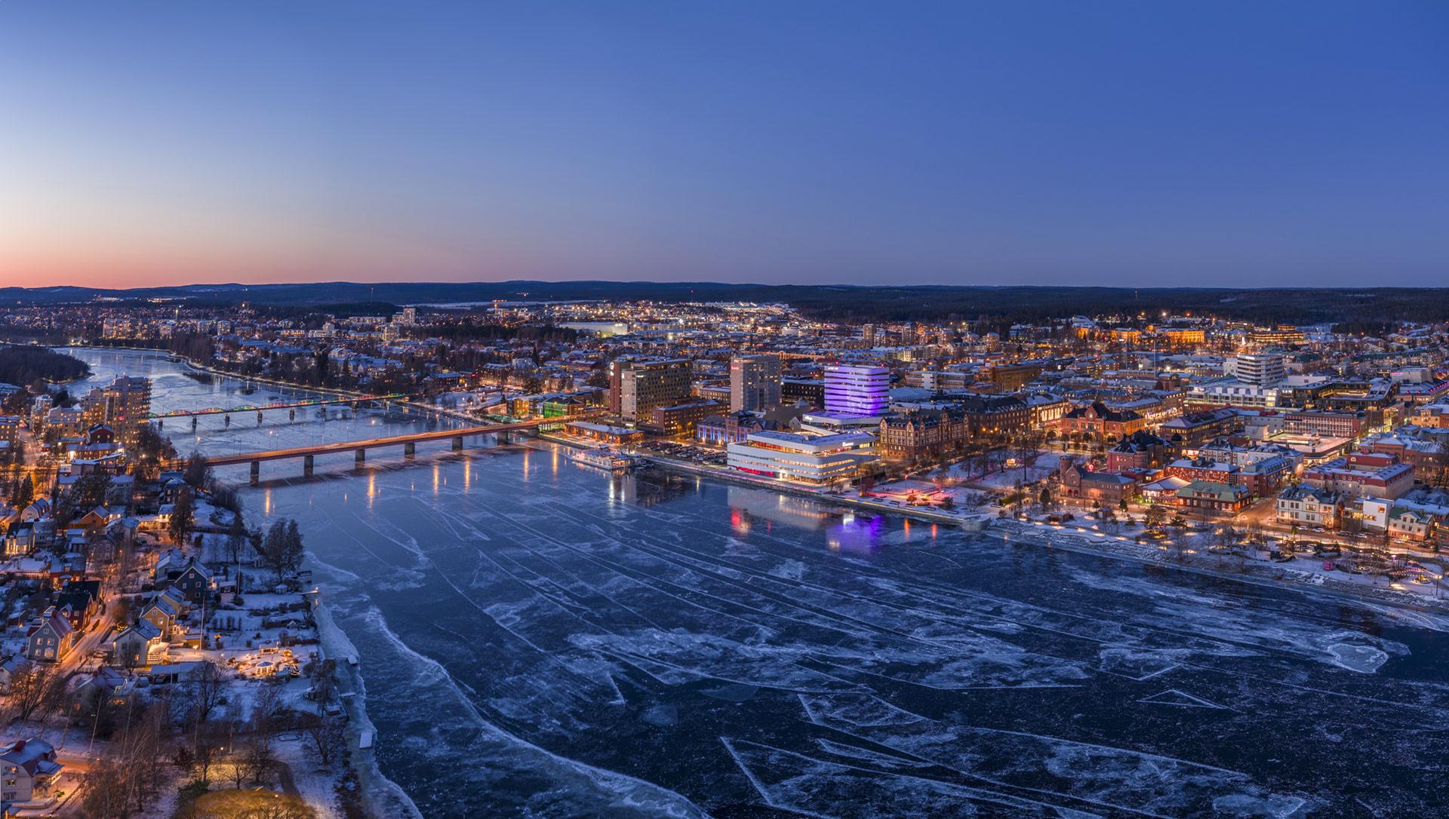
Welcome to umeå

Slide 2
sustainable growth
Umeå attracts young people. This is a key driver behind the strong population growth in northern Sweden’s fastest and most sustainably growing region.

Slide 3
+ 6 000
Work opportunities
+ 5 500
Residents
+ 4 000
Homes
Notes:
Exact figures: +5 348 in population
Data sources: SUN, Statistics Sweden (SCB)
2020-2024. (Increase from 2019).
Exact figures: +6 094 more employees
Data sources: SUN, Statistics Sweden (SCB) 2020-2024.
In an effort to minimise the housing shortage and create a more functional housing market, Umeå Municipality aims to build 2,000 homes per year in the coming years.
Exact figures: 3,799 homes 2024.
Data sources: SUN, Statistics Sweden (SCB)

Slide 4

A YOUNG CITY GROWING
Umeå attracts young people, contributing to strong population growth.
In the past five years: +5,500 population
Average age: 40 years
Notes:
In exact numbers: +5 348 inhabitants, 2020-2024, Source: SCB.
Averge age from 2024.

Slide 5

A STRONG BUSINESS SECTOR
The innovation‑driven and diverse business sector creates jobs and new types of employment.
Over the past five years:
+6,000 new jobs
Notes:
Exact figures: +6 094 more employees
Data sources: SUN, Statistics Sweden (SCB) 2020-2024.

Slide 6

Make room
For more
Target: 2,000 new homes to be built each year
Over the past five years:
+ 4,000 homes
Notes:
Exact number: 3 799 bostäder.
2020-2024.
Data: SUN, SCB.

Slide 7
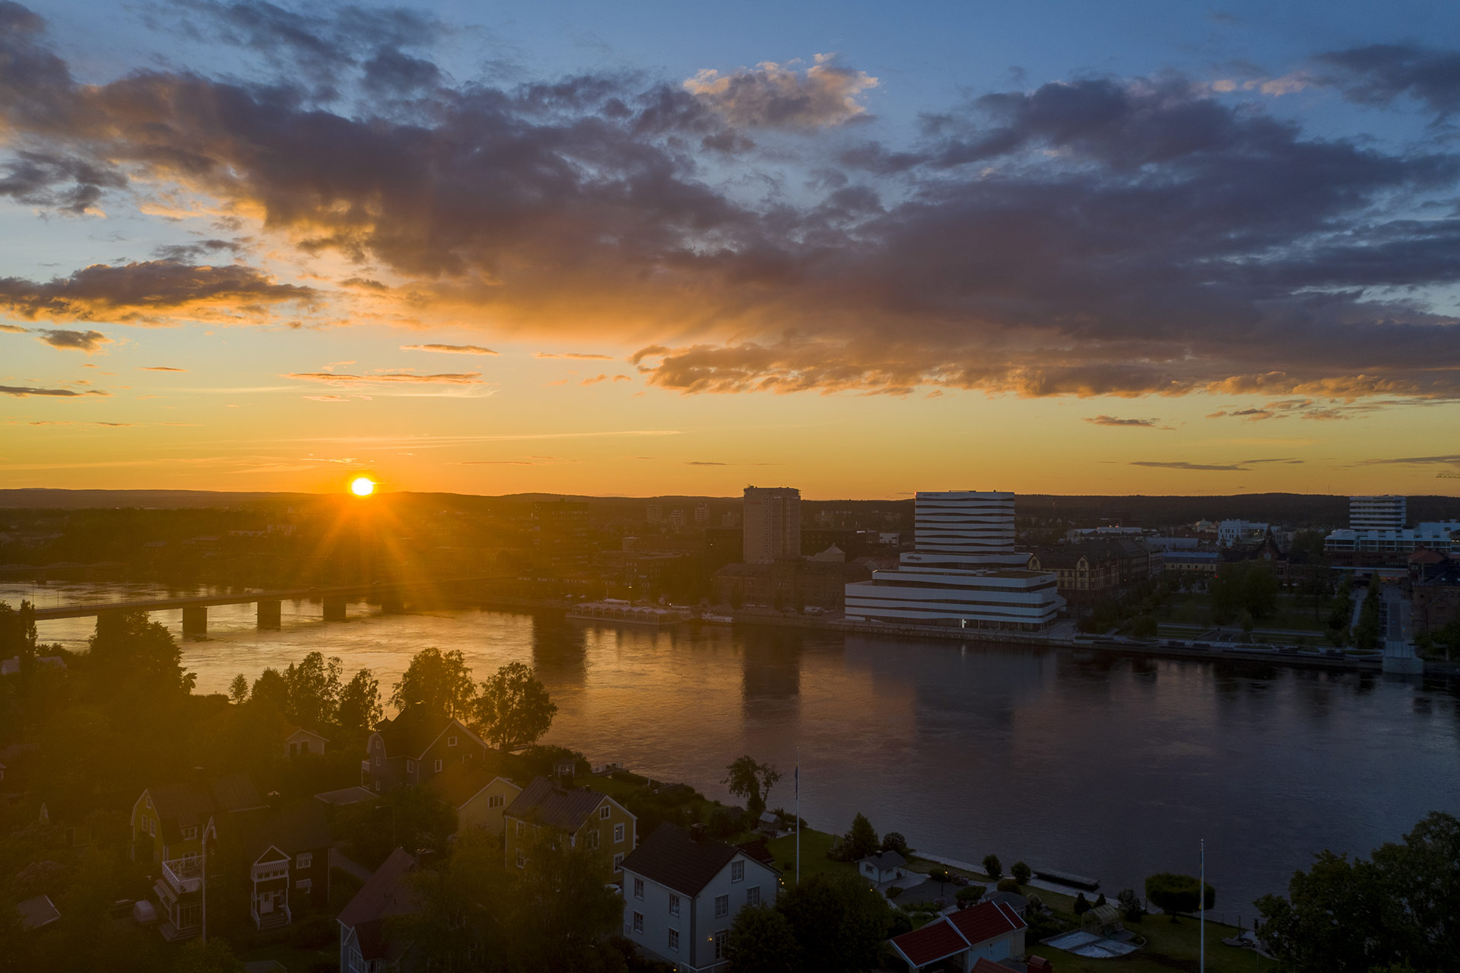
Umeå’s vision:
200 000 residents by 2050

Slide 8
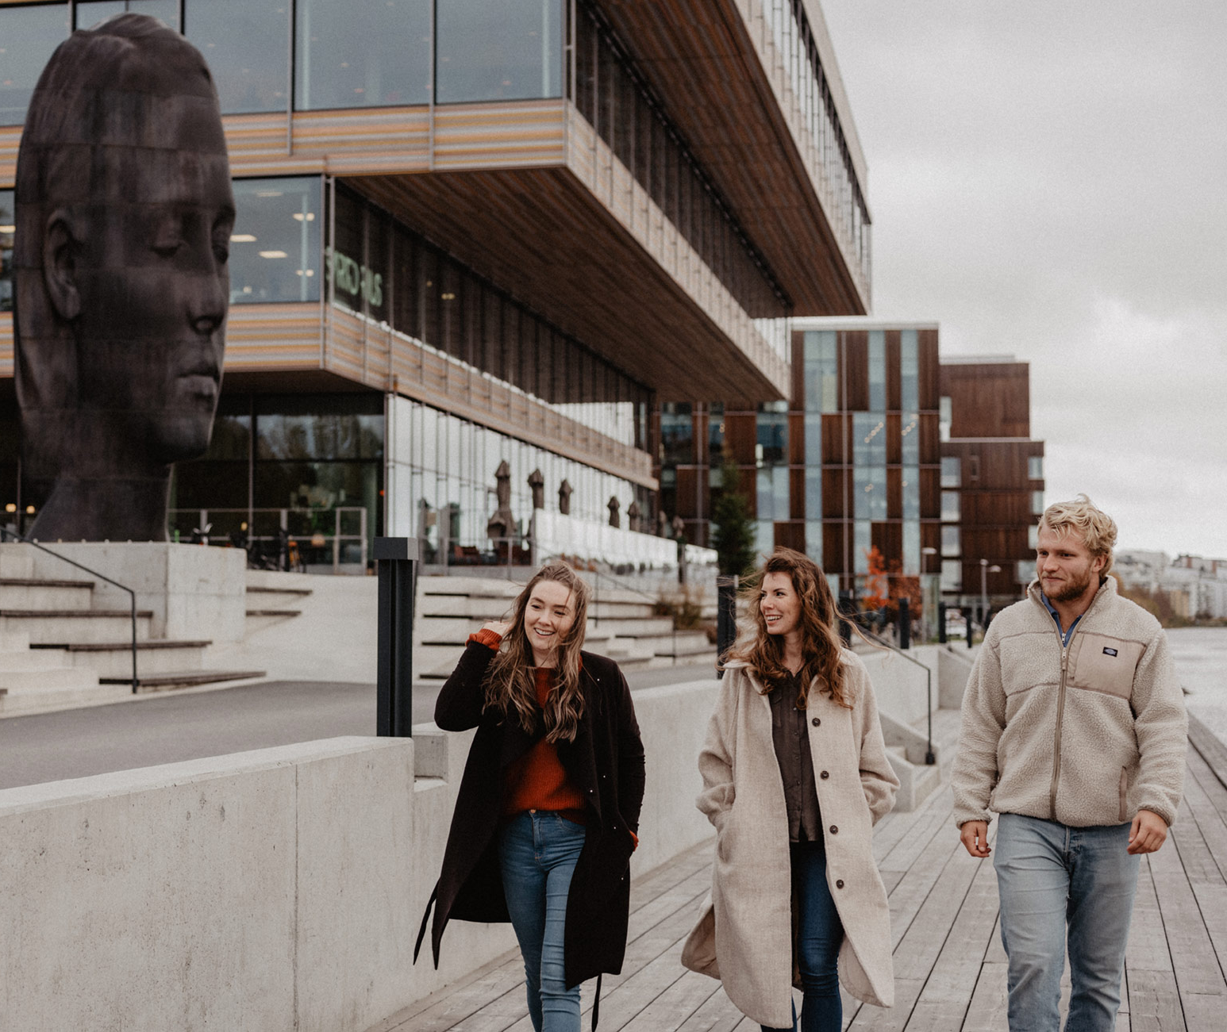
Population growth across all categories
Umeå has a young and highly educated population.
More than 135,000 people from all corners of the world live here today.
Notes:
Source: Umeå kommun. Inhabitants: 135 273 (december 2025)

Slide 9
Rapidly growing population
Index = 100
Indexed population growth in Swedish municipalities
Notes:
Chart showing indexed population change (mostly increases) over time for a selection of Swedish municipalities.
Data sources: SUN, Statistics Sweden (SCB)

Slide 10
Planning with Care
Umeå is planned with its residents' interest at heart. Growth is intended to be socially, ecologically, culturally, and economically sustainable.
Notes:
Umeå is being planned with its residents at the center. Growth is intended to be socially, ecologically, culturally, and economically sustainable

Slide 11
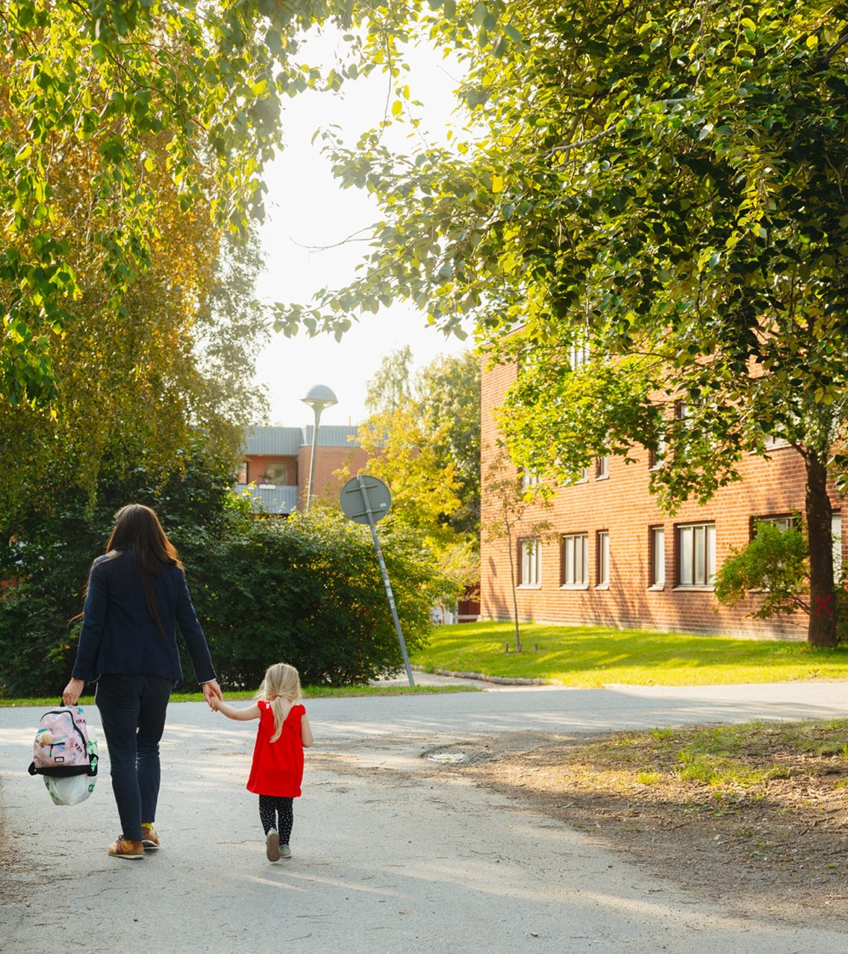
15-minute city
Planning for a denser Umeå makes sustainable living easier through closer access to everyday needs and amenities.

Slide 12

A low-risk investment
Umeå has one of Sweden's fastest-growing real estate markets.
Notes:
Newsec ranks Umeå in 6th place in its assessment of the real estate markets across Sweden’s 29 largest municipalities, as presented in Future Growth Markets No. 16 from 2024.

Slide 13
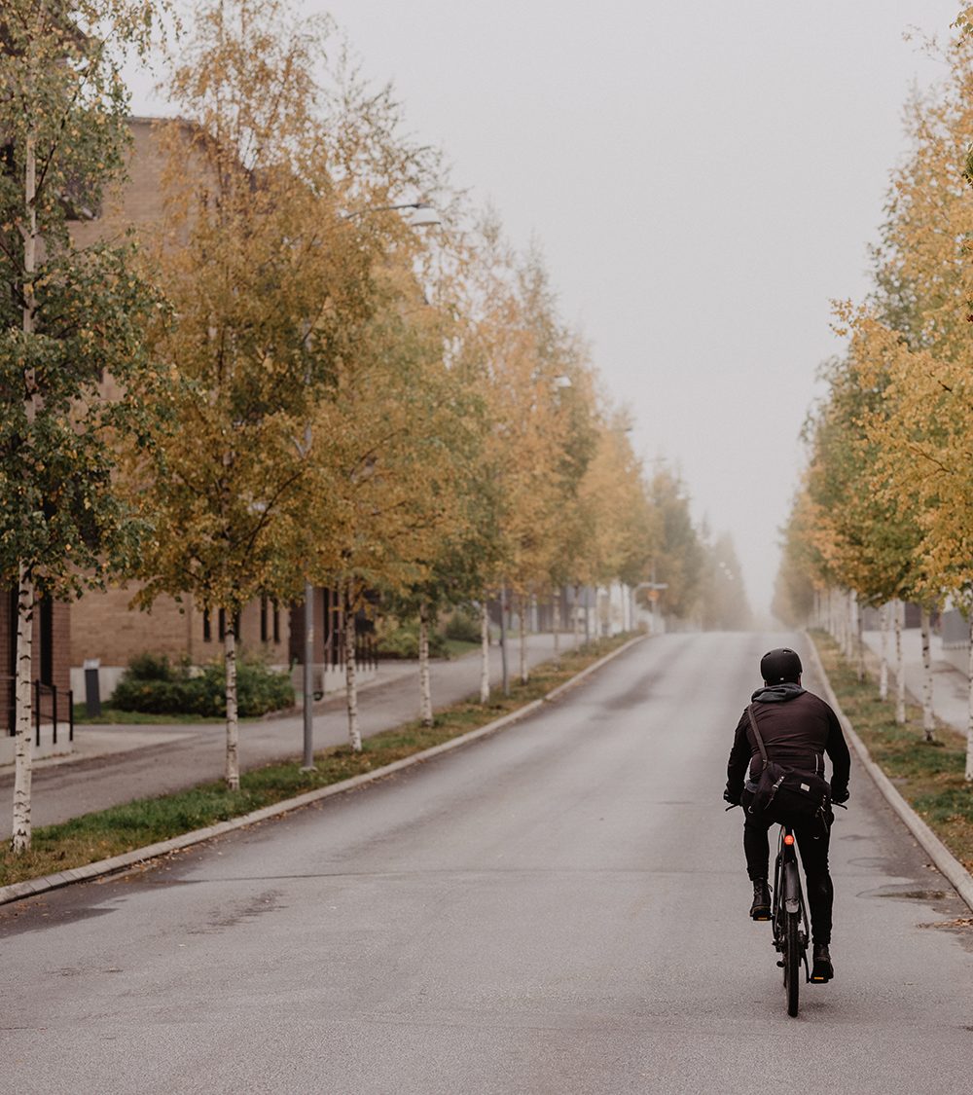
SUSTAINABLE TRANSPORT
90% of the homes being built in Umeå are in locations where cycling or taking the bus is the most convenient means of transport for daily commutes.

Slide 14
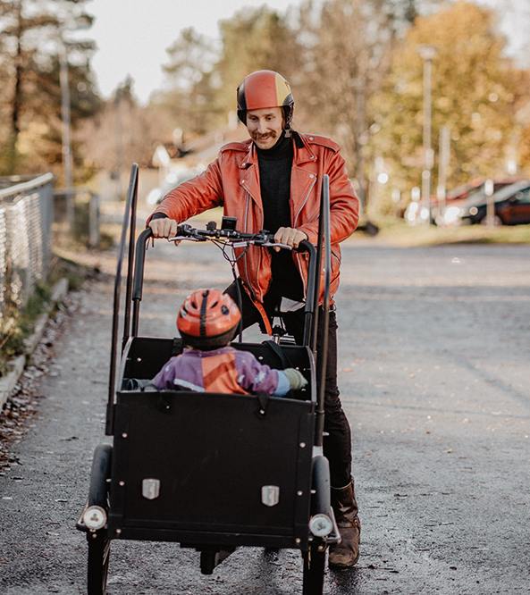
Safety for All
One of Sweden’s largest cities that does not have vulnerable residential areas impacted by criminal activity.

Slide 15

ALL OF UMEÅ WILL THRIVE
The countryside and city are growing at the same pace. One in three people in Umeå live outside the city.

Slide 16

EQUALITY
FOR REAL
30 years of strategic work towards gender equality have resulted in a city with high levels of safety, trust, and well-being.
The EU highlights Umeå’s approach as a model for gender equality across Europe.

Slide 17
Diverse
Expertise
Broad labor market, with access to skilled labor from two universities, several folk high schools and higher vocational education programs, as well as specialized secondary schools.

Slide 18

WELL-EDUCATED POPULATION
Over 50 % of the population hold a university degree, and nearly 90 % have completed upper secondary education or higher.
Notes:
Figures from 2023:
More than 50% have post-secondary education and 37% have completed upper secondary education — meaning nearly 90% have secondary-level education or higher.
Data sources: SUN, Statistics Sweden (SCB)

Slide 19
Achieving more together
High measured levels of social trust and strong collaborative ability are believed to contribute to Umeå’s rapid growth and high quality of life.
Notes:
According to Gemenskapsbarometern 2024 and surveys by Statistics Sweden (SCB), nearly 80 percent of Umeå residents trust each other.
(Gemenskapsbarometern 2024, delrapport 1). Umeå is number one in Sweden.

Slide 20
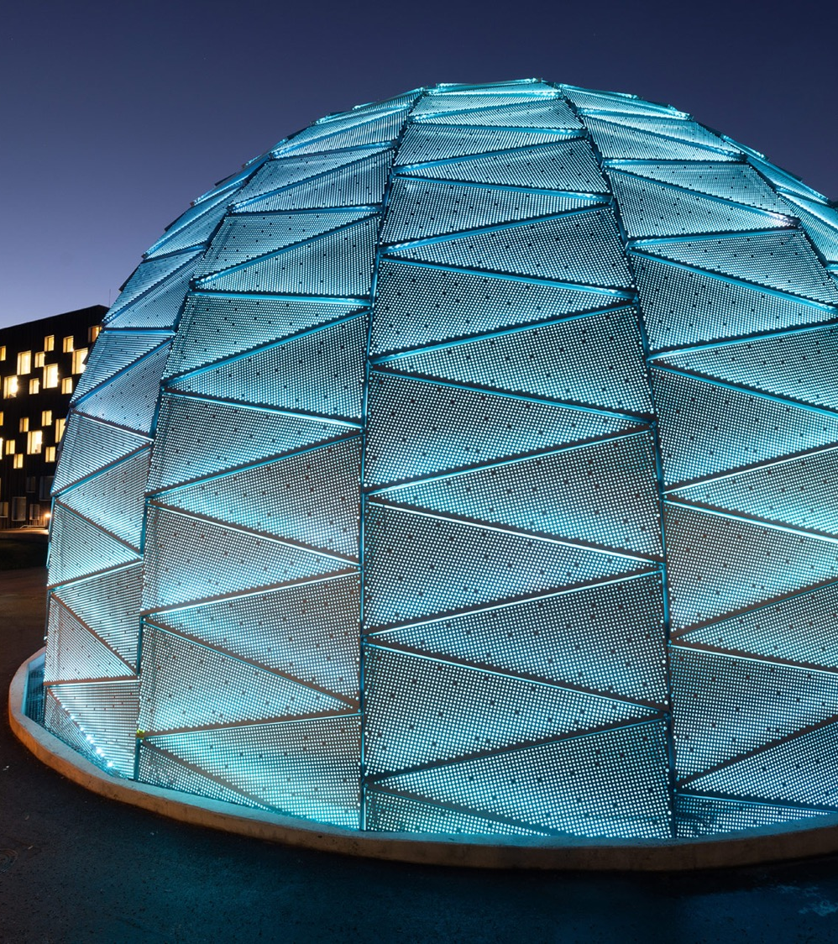
CLOSE TO KNOWLEDGE
The attentive education system meets demands for expertise and specialisation across multiple levels.

Slide 21

Trust & growth
When there is trust, it becomes easier to conduct business and develop the common good.
Notes:
According to Gemenskapsbarometern 2024 and surveys by Statistics Sweden (SCB), nearly 80 percent of Umeå residents trust each other.
(Gemenskapsbarometern 2024, delrapport 1). Umeå is number one in Sweden.

Slide 22
Research
& education
Umeå is home to cutting-edge research environments that have fostered Nobel Prize laureates, and internationally renowned academic programmes across its two universities.

Slide 23

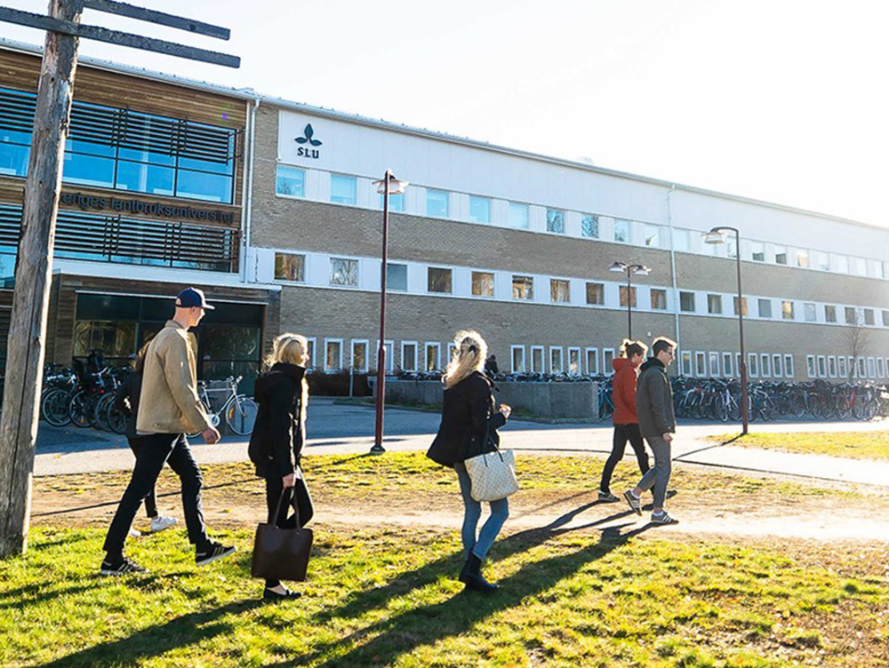
Umeå University conducts leading research and is a comprehensive university with approximately 44,000 students and over 4,500 employees.
SLU Umeå conducts world‑leading forestry research as well as studies into northern Swedish agriculture.
Notes:
Source: Umeå universitet, årsredovisning 2024.

Slide 24
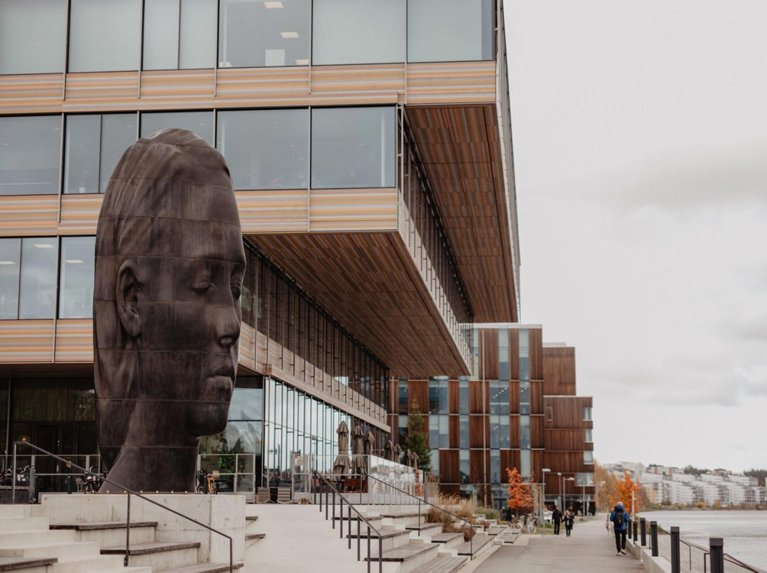
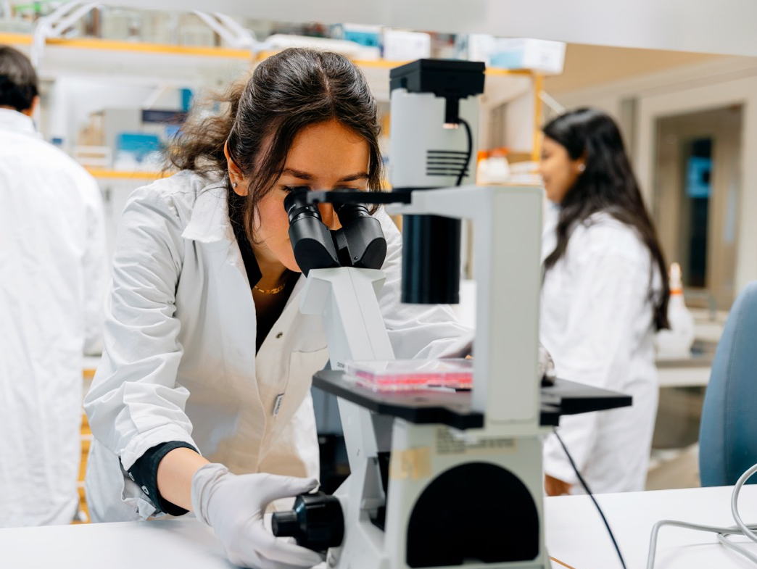

The Arts Campus brings together artistic education and institutions.
The groundbreaking discovery of the
gene-editing tool CRISPR-Cas9, which was awarded the Nobel Prize in Chemistry, was made by Emmanuelle Charpentier at Umeå University.

Slide 25
A hub in the north
Robust infrastructure at regional,
national and international levels.

Slide 26
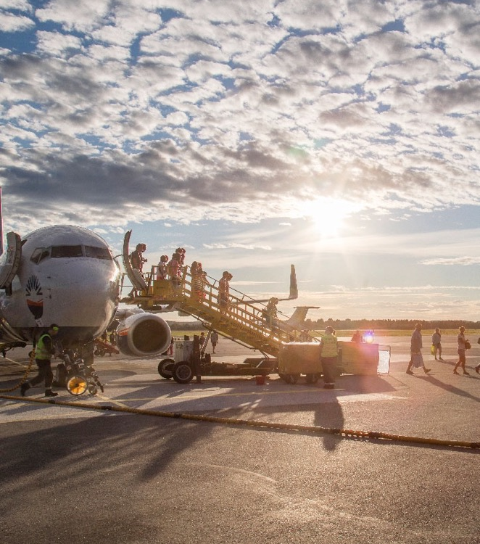
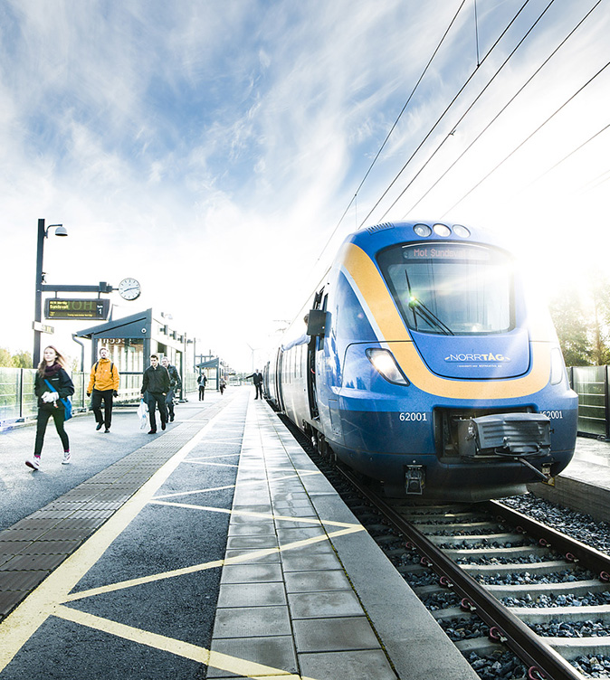
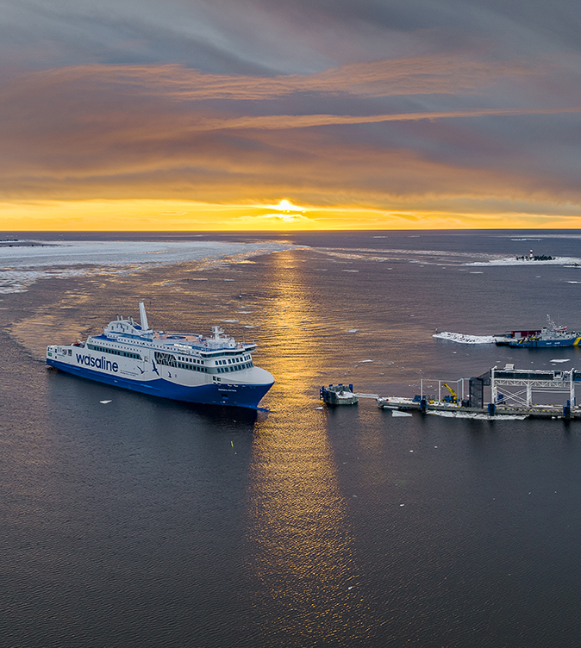
Umeå Airport – just ten minutes from the city centre.
The Bothnia and North Botnia railway lines.
Making significant investments in port and logistics operations.

Slide 27

Sustainability in every decision
Environmentally conscious citizens and ambitious climate goals.
The municipality aims to be climate-neutral by 2040 at the latest.
Notes:
Umeå is one of the selected cities participating in the EU Mission for 100 climate-neutral cities by 2030.

Slide 28


Work x life
Work‑life balance. With a broad offering and a welcoming atmosphere – Umeå allows you to do the things you like, and to be yourself.

Slide 29

Living well, the northern way
Northern Sweden ranks among the top regions in Europe when the EU assesses quality of life.
According to an independent survey from 2024, Umeå is the best municipality in Sweden to live and reside in.

Slide 30

a more equal distribution
Umeå sets the standard for gender‑equal parental leave, with residents sharing leave more evenly between genders than in other parts of Sweden.
Notes:
Source: Källa ISF, inspektionen för socialförsäkringen, ISF RAPPORT 2024:5
In the municipalities where the highest share of parents split parental leave equally (Umeå, Stockholm and Solna), around 26 percent share the paid leave equally, while the share who divide the total parental leave equally is about 9 percentage points lower, that is, 16–18 percent. Looking at fathers’ share of couples’ paid and total parental leave, we can also see that parents share the most equally in Umeå, Stockholm and Solna.

Slide 31

Women feel at home in Umeå
Umeå is one of the Swedish cities where women enjoy the highest levels of well‑being.
It’s also among the top cities most women recommend to others.
Notes:
Source: SCB, Citizen Survey, 2025.
98.8% of women in Umeå agree with the statement “The municipality is a good place to live,” and 83.4% agree with the statement “I can recommend others to move to the municipality.” This can, for example, be compared with the national averages, which are 93.3% and 64.2% respectively for the corresponding questions.

Slide 32
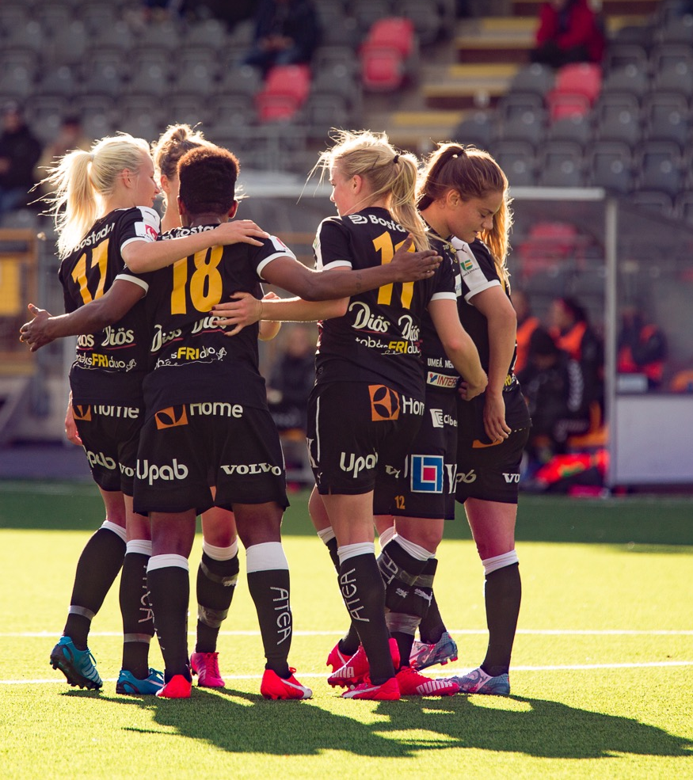
equality in sports
Umeå’s commitment to gender‑equal sports is evident through a wide range of elite clubs on both the women's and men's sides.
Umeå is one of Sweden’s top sports municipalities and consistently ranks among the best in national rankings.

Slide 33

Sustainable society
Sustainability with people at the heart. Always.
Active environmental action in collaboration between the municipality, the university and the business community
Climate City of the Year 2016. European Green Capital finalist in 2014, 2015 and 2016
Umeå climate roadmap – Umeå aims to be climate-neutral by 2040, at its latest.

Slide 34

Music runs deep
Music city with celebrated bands and a strong DIY tradition

Slide 35
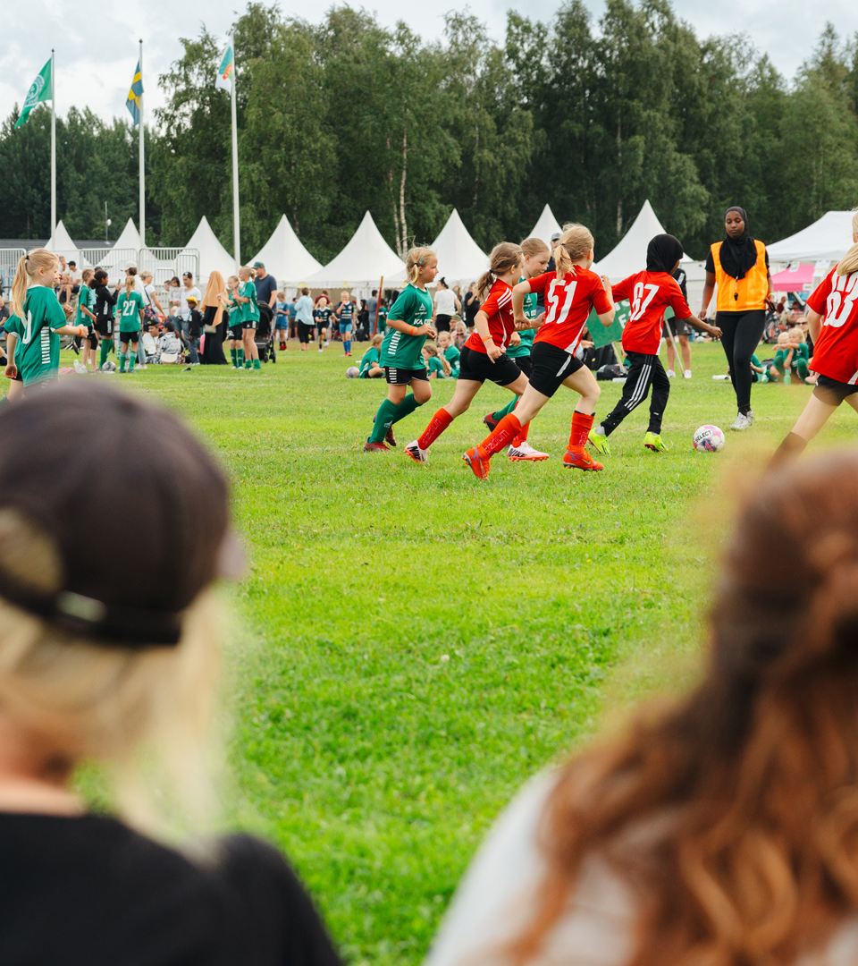
Sports on equal terms
Umeå was an early adopter of gender-equal allocation of training hours.
An initiative that delivers results through major sporting successes, especially in women’s sports.

Slide 36
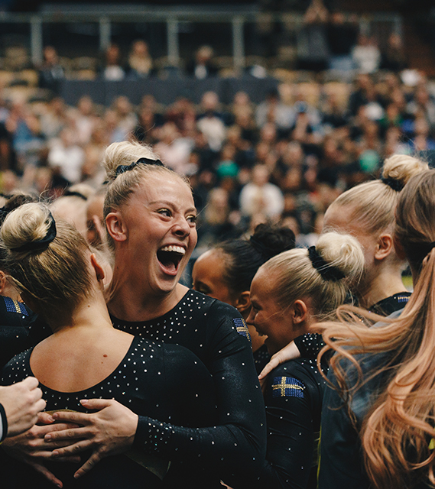
Sport and education
In Umeå, elite athletes can pursue high‑performance training alongside university studies. Through dual careers, they continue to grow in their sport while building a strong foundation for life beyond athletics.
Notes:
At Idrottshögskolan, (the School of Sport Sciences), elite athletic training is combined with university studies — an in opportunity available in only a few places in Sweden.

Slide 37
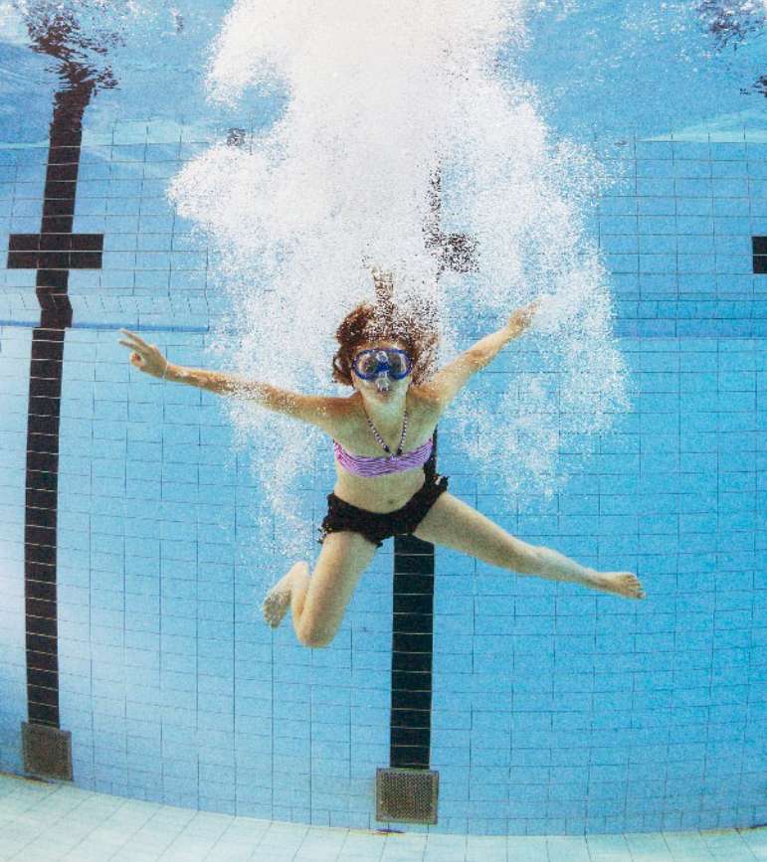
Health and well-being
IKSU has one of the largest sports facilities in Europe and is one of the many fitness and recreational venues available in the region.

